Slide 1
TMDLs, What’s Next?
Presented by INCOG
August 12, 2022
Nienhuis Park Center, Broken Arrow

Slide 2
TMDls Affected by MS4 stormwater discharges
TMDL Report | Identified MS4 Sources
Neosho River Basin - Bacteria (2008) | Miami
Lower Bird Creek Watershed - Bacteria (2011) | Catoosa, Broken Arrow, Owasso, Tulsa, Tulsa County
Arkansas River and Verdigris River Area - Bacteria and Turbidity (2012) | Bixby, Broken Arrow, Claremore, Coweta, Jenks, Muskogee, Sand Springs, Sapulpa, Tulsa
Arkansas River and Haikey Creek - Bacteria (2008) | Bixby, Broken Arrow, Tulsa, Tulsa County
North Canadian River Area – Bacteria (2010) | Choctaw, Del City, Midwest City, Moore, Mustang, Nicoma Park, ODOT, Oklahoma City, Spencer, Tinker Airforce Base, Yukon
Lake Thunderbird – Nutrient, Turbidity, Dissolved Oxygen (2013) | Moore, Norman, Oklahoma City
Cimarron River Area – Bacteria and Turbidity (2012) | Oklahoma City (with ODOT as Copermittee), The Village
Salt Fork of the Arkansas River Area – Bacteria and Turbidity (2011) | Ponca City

Slide 3
IV. B. Established Total Maximum Daily Load (TMDL) Allocations
Update your SWMP within 2 years to reflect TMDL requirements
List all approved TMDLs or watershed plans applicable to your MS4
“Your MS4 shall participate in a coordinated regional pollutant reduction plan or develop their own individual plan.” Note which course you will be taking.
State which TMDL Implementation Schedule (A or B) you will be following.

Slide 4
Monitoring Requirements:
At a minimum, the monitoring plans(s) shall provide
A detailed description of the program goals, monitoring plan, and sampling and analytical methods,
A list and map of the selected TMDL pollutant monitoring sites,
The frequency of data collection to occur at each station or site,
The parameters to be measured relevant to the TMDL(s), and
The Quality Assurance Project Plan (QAPP) that complies with EPA requirements.

Slide 5
Table IV-1 TMDL Implementation Schedule
 | Option A | Option B
SWMP review and evaluation | No more than two years from TMDL effective date
TMDL pollutant baseline monitoring plan | ------ | No more than three years from TMDL effective date
TMDL pollutant reduction plan | No more than three years from TMDL effective date | No more than 5 years after implementation of the baseline monitoring plan
TMDL pollutant monitoring plan | No more than three years from TMDL effective date | No more than 5 years after implementation of the baseline monitoring plan

Slide 6
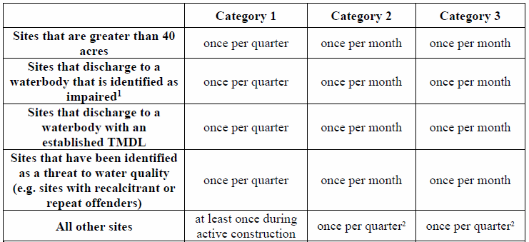

Table V-5 Minimum frequency of construction site inspections
¹ Sites that discharge within 1 stream mile of a waterbody that is impaired for sediment or turbidity
² You may develop and implement procedures and criteria for reducing the inspection frequency. However, at a minimum, sites shall be inspected at least once during active construction. Such procedures and criteria shall be documented in your SWMP

Slide 7
Annual Reporting:
Your MS4 shall include a TMDL implementation report as part of your annual report
Relevant actions taken during the reporting cycle,
Number of sampling (monitoring) sites and locations,
Number of samples collected per site and total,
Analytical results,
Result summaries, and
Anticipated changes to the baseline monitoring plan.

Slide 8
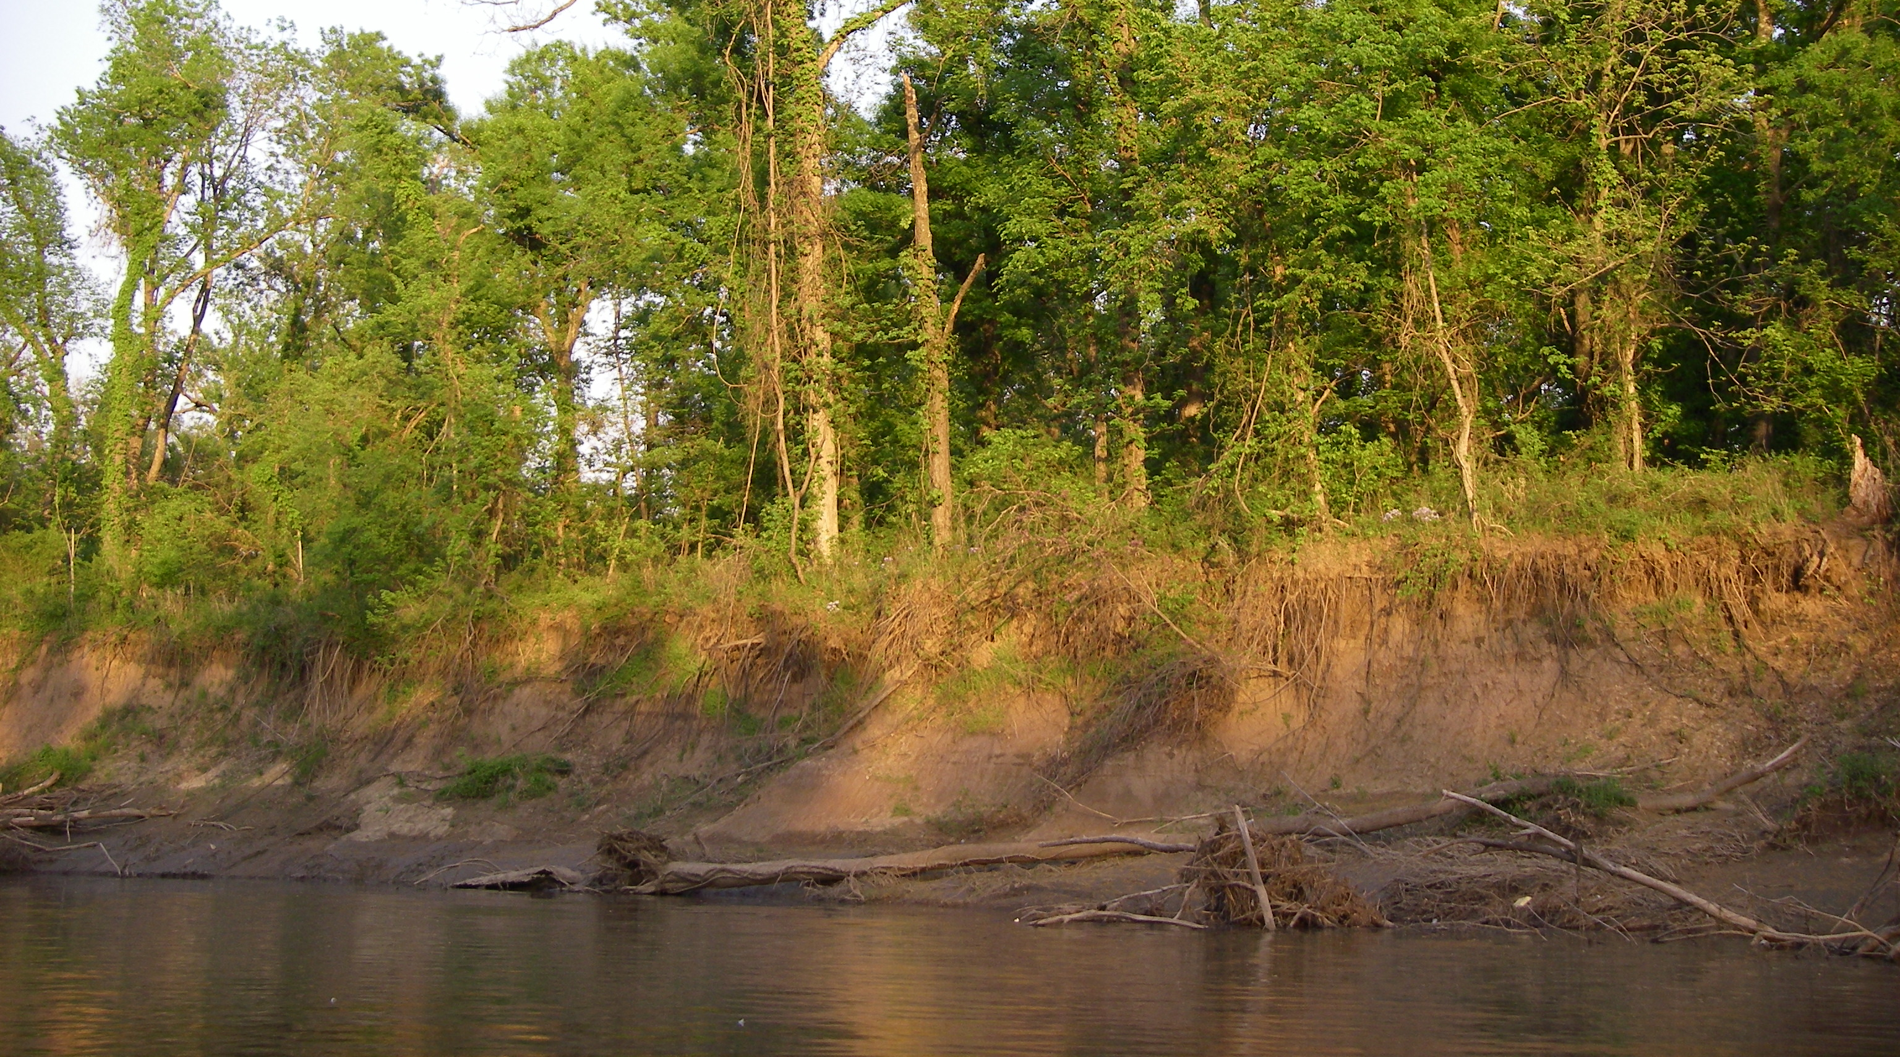
Vernon Seaman
Water Quality Specialist
INCOG
918-579-9451 (Office)
918-899-6166 (Cell)

